Slide 1
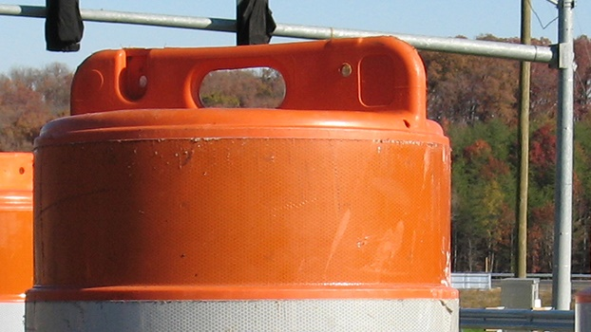

Road Safety
Assessing Safety Challenges
Greg Driskell
PPP, Inc.
Greg.Driskell@pppcatalog.com

Slide 2

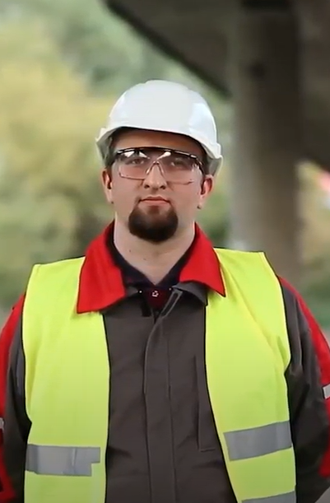
User
Worker

Slide 3
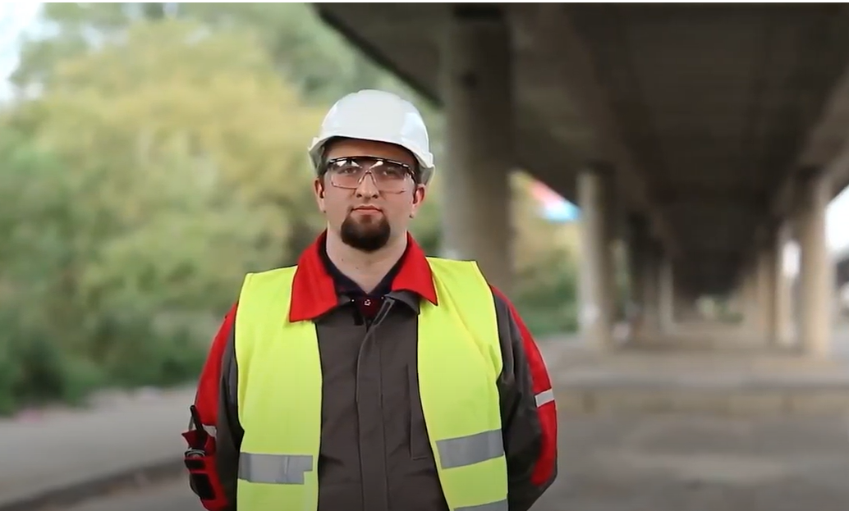
Worker

Slide 4
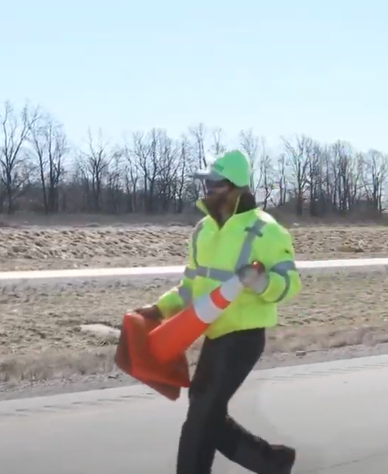

Prevention
Protection

Slide 5
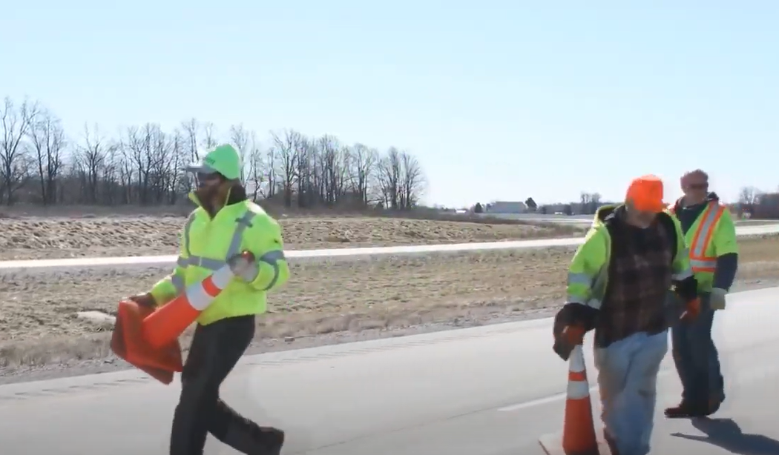
Prevention

Slide 6
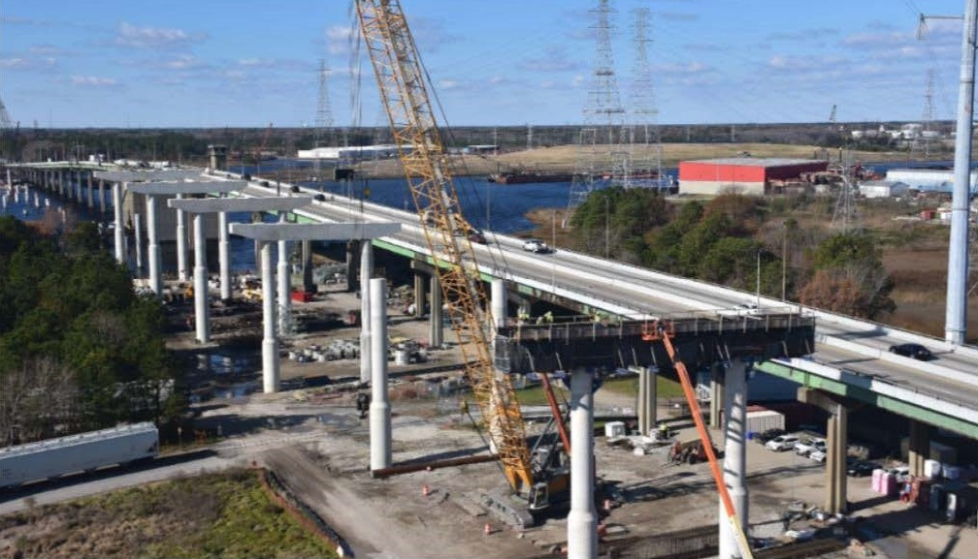
Maintenance and Construction

Slide 7
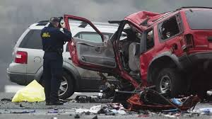
Fatalities

Slide 8

Distracted Driving

Slide 9

Safety Costs

Slide 10

Necessary Evil?

Slide 11

Focus

Slide 12

Paradigm Shift

Slide 13

Uniformed

Slide 14
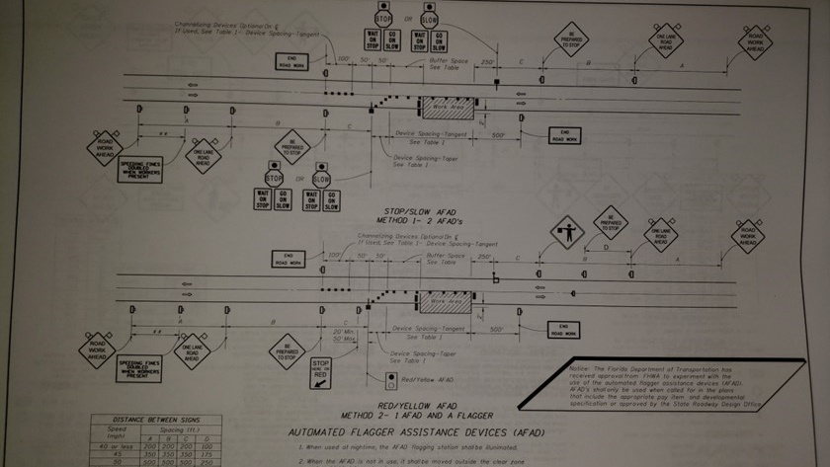
Better than the Basics

Slide 15
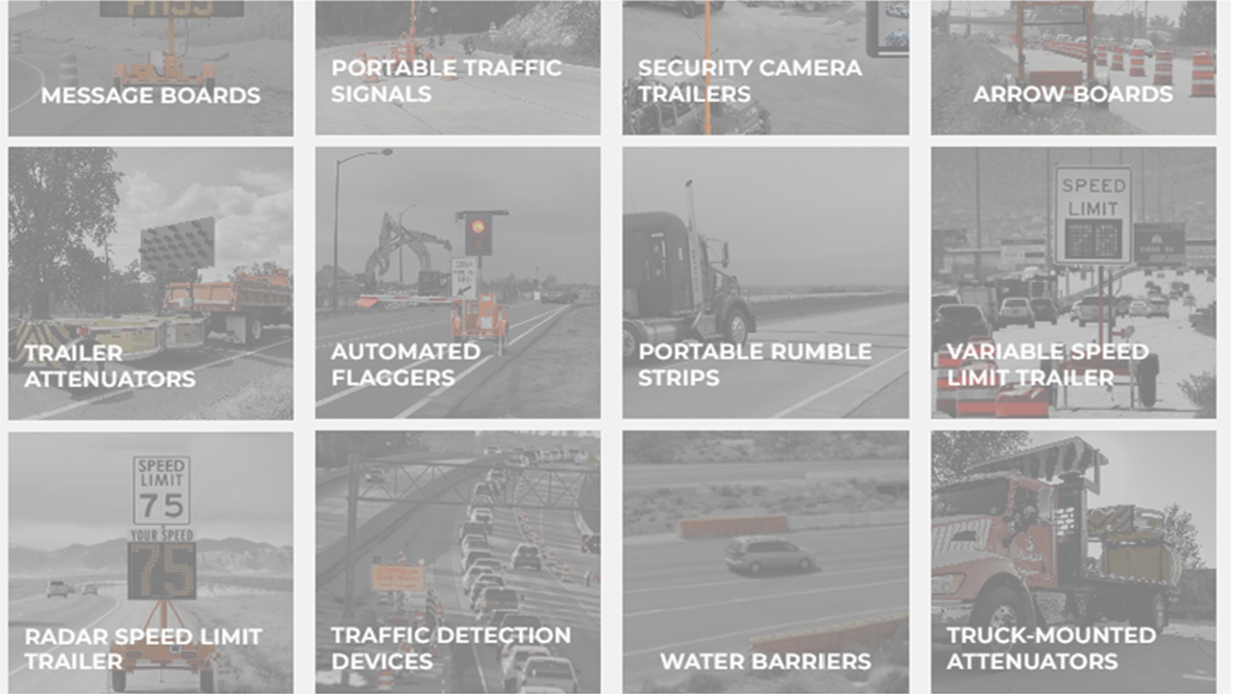
Better Innovative Technologies

Slide 16
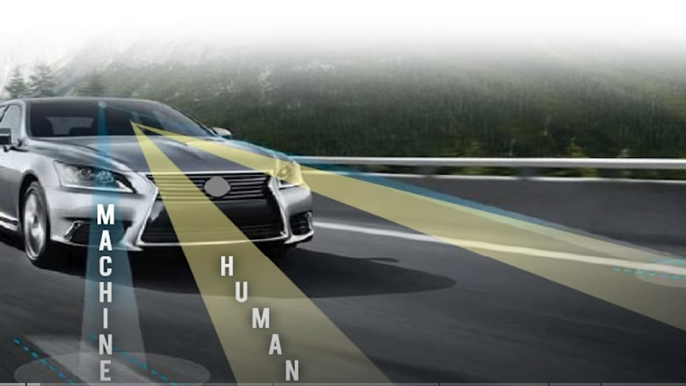
Development or Pilot Deployment

Slide 17
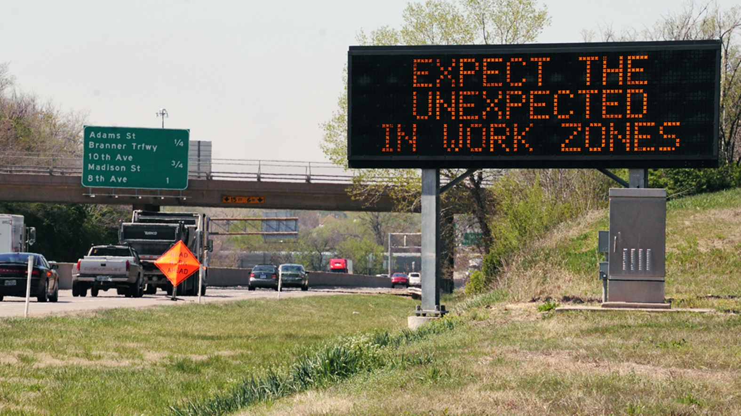
Deployed Communication Innovations

Slide 18

Deployed Equipment and Devices

Slide 19
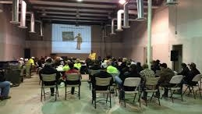
Better Training

Slide 20
Better Funding

Slide 21
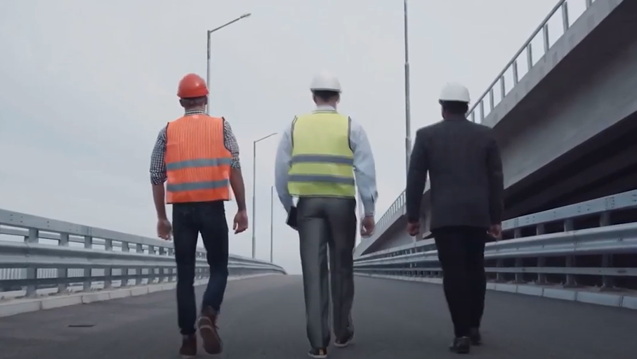
Personal Responsibility

Slide 22

Road Safety
Greg Driskell
PPP, Inc.
Greg.Driskell@pppcatalog.com

